Slide 1

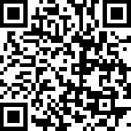




Join with other Christ followers to meet the urgent need!
DONATE BLOOD THIS EASTER
When: Saturday, March 14 , Saturday, March 21, 2026
Where: Canadian Blood Services (1575 Carling Ave, Ottawa)
Visit
easterblooddrive.ca
for more information

