Slide 1

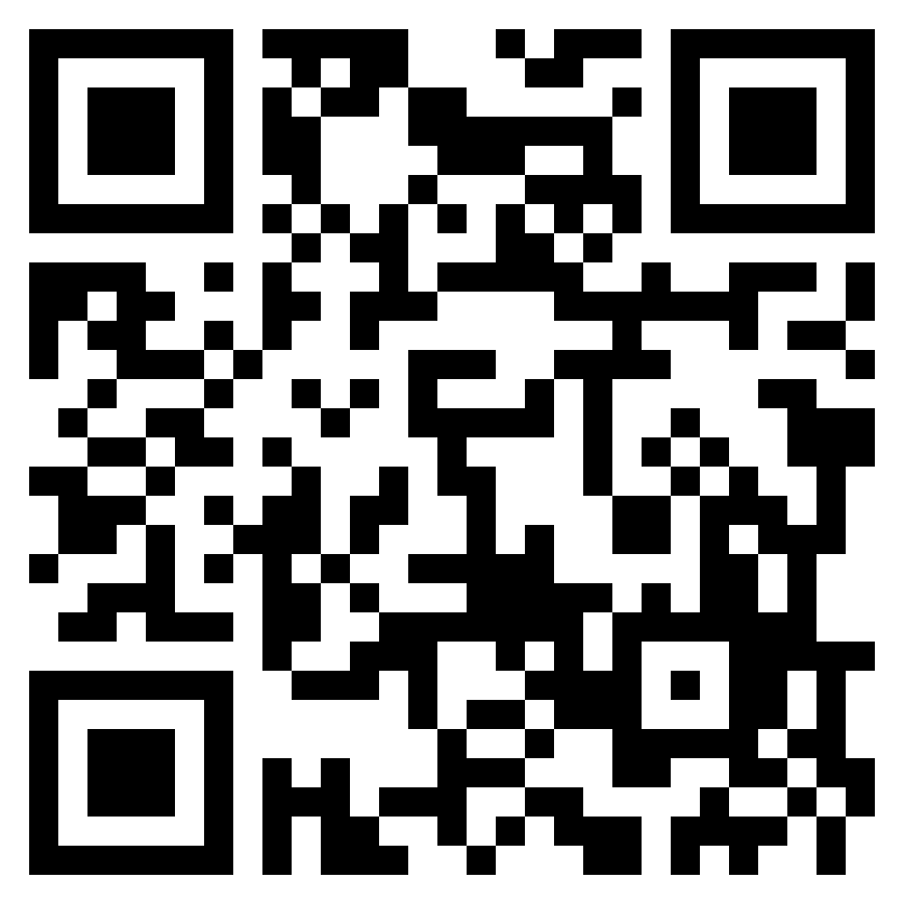




Join with other
Christ followers to meet the urgent need!
.
When: March 29 – April 5, 2025
Where: Canadian Blood Services
1575 Carling Ave, Ottawa
Plasma Donor Centre
110 Place d’Orléans Unit 1120
Join the Easter
Blood Drive
team:
Visit easterblooddrive.ca
for more information
ONEW0108432
Easter Blood Drive

Slide 2
Jesus shed His blood for us – now it is our turn, in appreciation of His sacrifice.
.
How: Step 1 - Sign in or create your
personal donor account with
Canadian Blood Services at
myaccount.blood.ca
Step 2 - In your account, click on
the “Join a Team” button. Type
in and/or select the “Easter
Blood Drive” team.
Step 3 - Book your appointment to
donate blood or plasma.
Visit easterblooddrive.ca
for more information.

