Slide 1

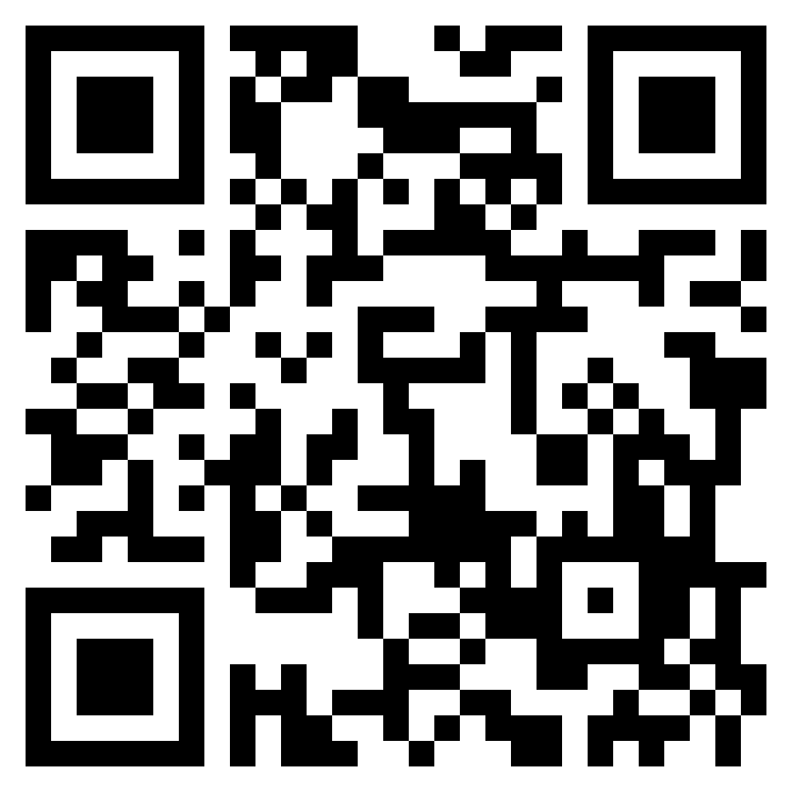




Join with other Christ followers to meet the urgent need!
Donate blood or plasma this Easter.
When: Saturday, March 29 - Saturday, April 5, 2025
Create an account online at myaccount.blood.ca, select
the Easter Blood Drive team, then book an appointment.
Where: Canadian Blood Services (1575 Carling Ave, Ottawa)
Plasma Donor Centre (110 Place d'Orléans Unit 1120)
Join the Easter
Blood Drive team:
Visit
blooddrive.loveottawa.ca
for more information.
ONEW0108432
Easter Blood Drive

